Slide 1
Micro Gas Turbine Electrical Energy
Presented by - Agaba & Jonah
Affiliation: Makerere University
Uganda
Authors:
1. Agaba Lucky
2. Kyagaba Jonah

Slide 2
Micro Gas Turbine Electrical Energy Prediction
In the context of rising energy demands and a global push towards sustainable and decentralized power systems, micro gas turbines (MGTs) have emerged as a viable solution. MGTs are small-scale, high-efficiency power generation units that can operate on various fuels, including natural gas and biogas. They are increasingly deployed in microgrids and hybrid energy systems to provide reliable power, often complementing renewable sources like solar and wind. However, accurately predicting the electrical energy output of MGTs remains a challenge due to the complex interplay of factors affecting their performance, such as environmental conditions, fuel characteristics, and machine parameters. Machine learning (ML) offers powerful tools for modeling and prediction in this domain, enabling real-time adjustments that optimize efficiency, enhance reliability, and support grid stability. This study focuses on applying machine learning to predict MGT electrical energy output, with the goal of improving efficiency, minimizing operational costs, and ensuring consistent power delivery.

Slide 3
Dataset type: Regression
The dataset contains 52,940 entries with three columns: The three columns include;
time: A continuous variable representing time in seconds.
input_voltage: A continuous variable representing the input voltage (float).
el_power: A continuous variable representing electrical power output.
Research Questions
How does input voltage relate to electric power consumption?
What are the trends and patterns in electric power usage over time?
Is there an optimal input voltage range that minimizes electric power usage?
Can we forecast electric power demand based on historical data?
Does the variability in input voltage impact electric power stability?
Are there specific time intervals associated with higher or lower input voltage?

Slide 4
Data Wrangling Handling Missing Values
The dataset contained no missing values. Each column had complete data for all 52,940 entries, making it unnecessary to impute or drop data based on missing values.
Handling Outliers;
There were no outliers detected in this dataset for either input_voltage or el_power based on the interquartile range (IQR) method. All values fall within the calculated bounds:
Input Voltage: No values are outside the range of -3.63 to 14.05.
Electric Power: No values are outside the range of -584.77 to 4189.93.
The data is well-contained within typical ranges for both variables.

Slide 5
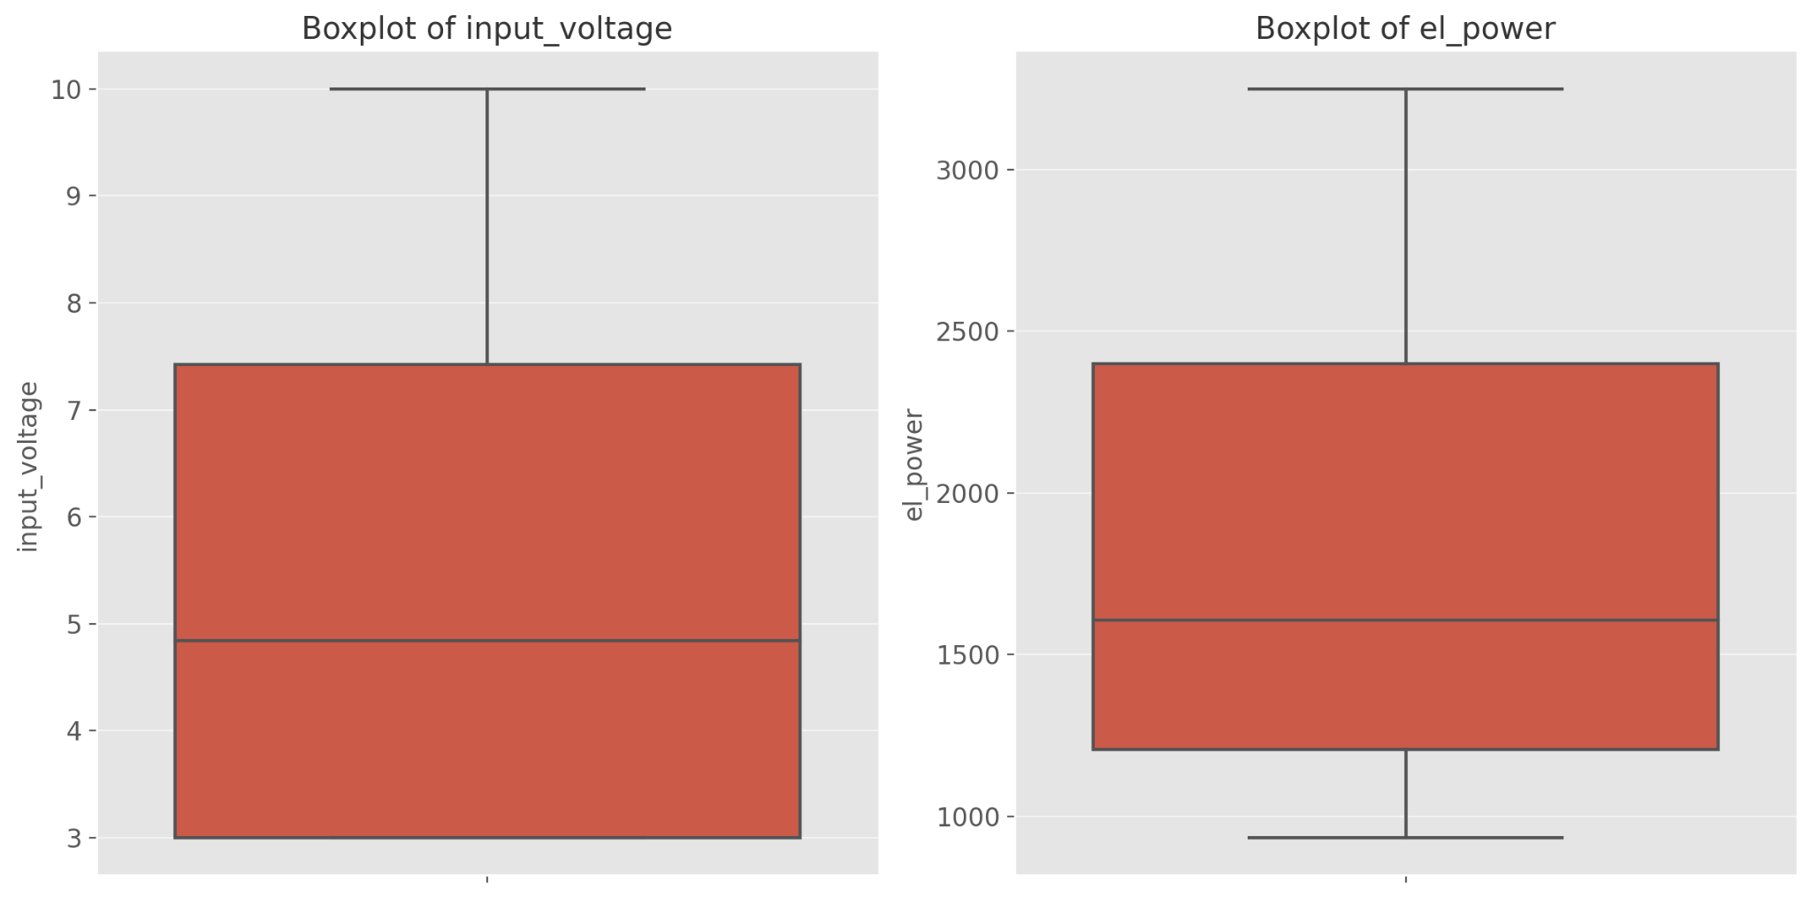
The boxplots for input_voltage and el_power visually confirm that there are no apparent outliers, as all data points fall within the typical range for each feature.

Slide 6
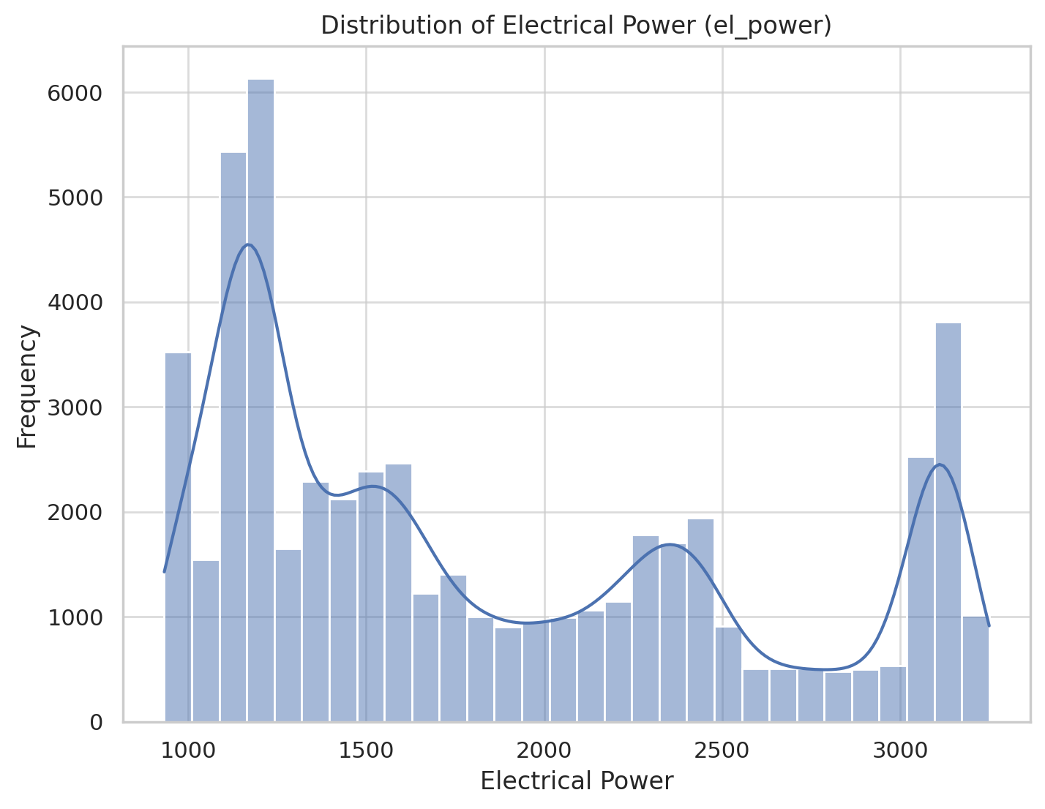
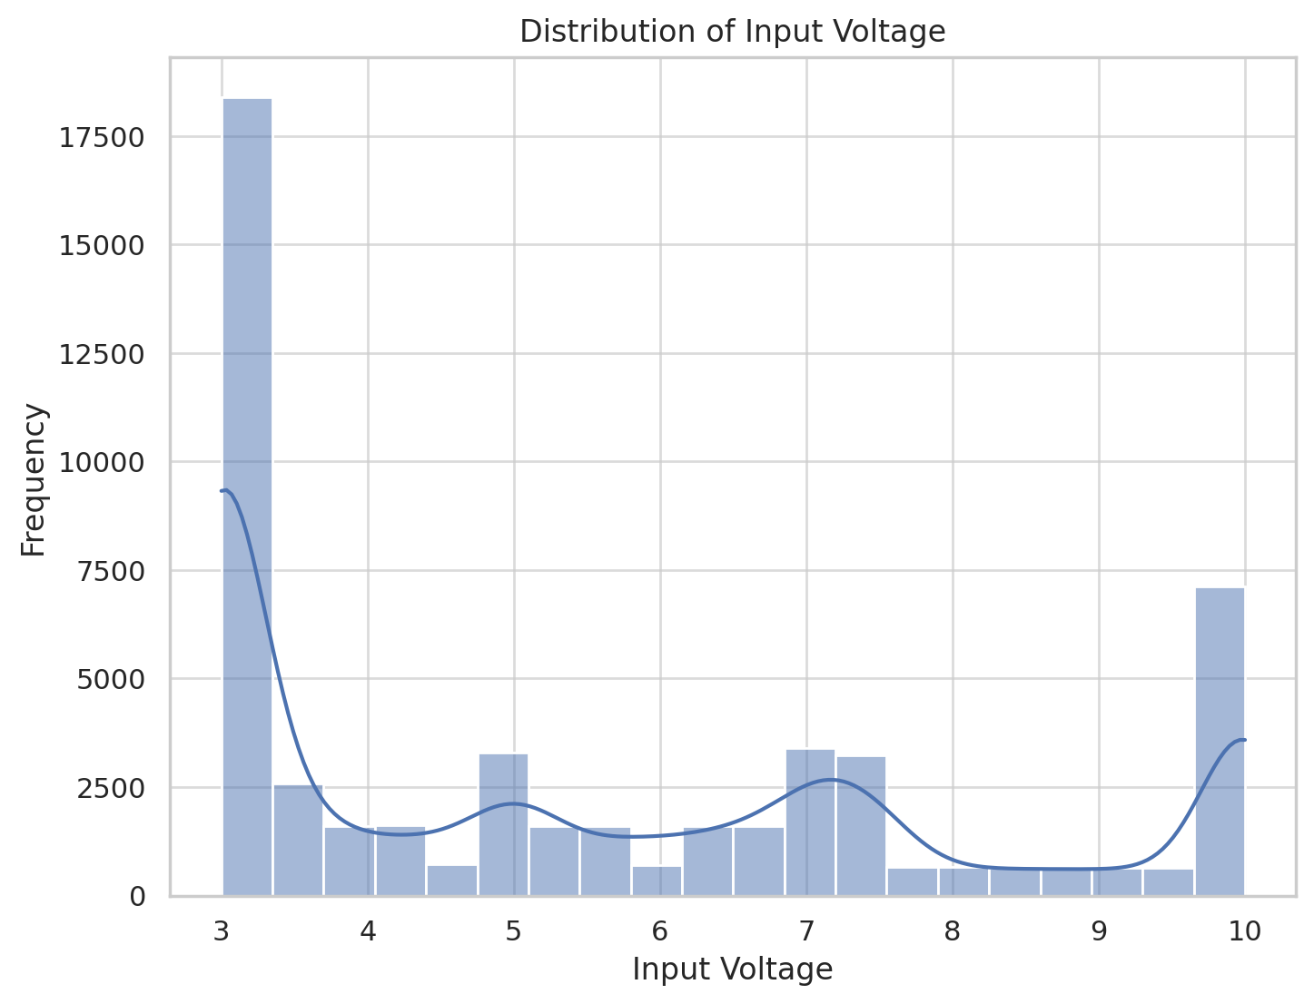
Distribution Analysis
Distribution of Input Voltage: The input voltage appears to be roughly bimodal, with peaks around 3 and 10. This suggests that the voltage may alternate between certain levels or there may be specific conditions leading to different operating ranges.
Distribution of Electrical Power: The electrical power (el_power) has a right-skewed distribution, indicating a concentration of values at the lower end, with fewer instances of high-power readings.

Slide 7
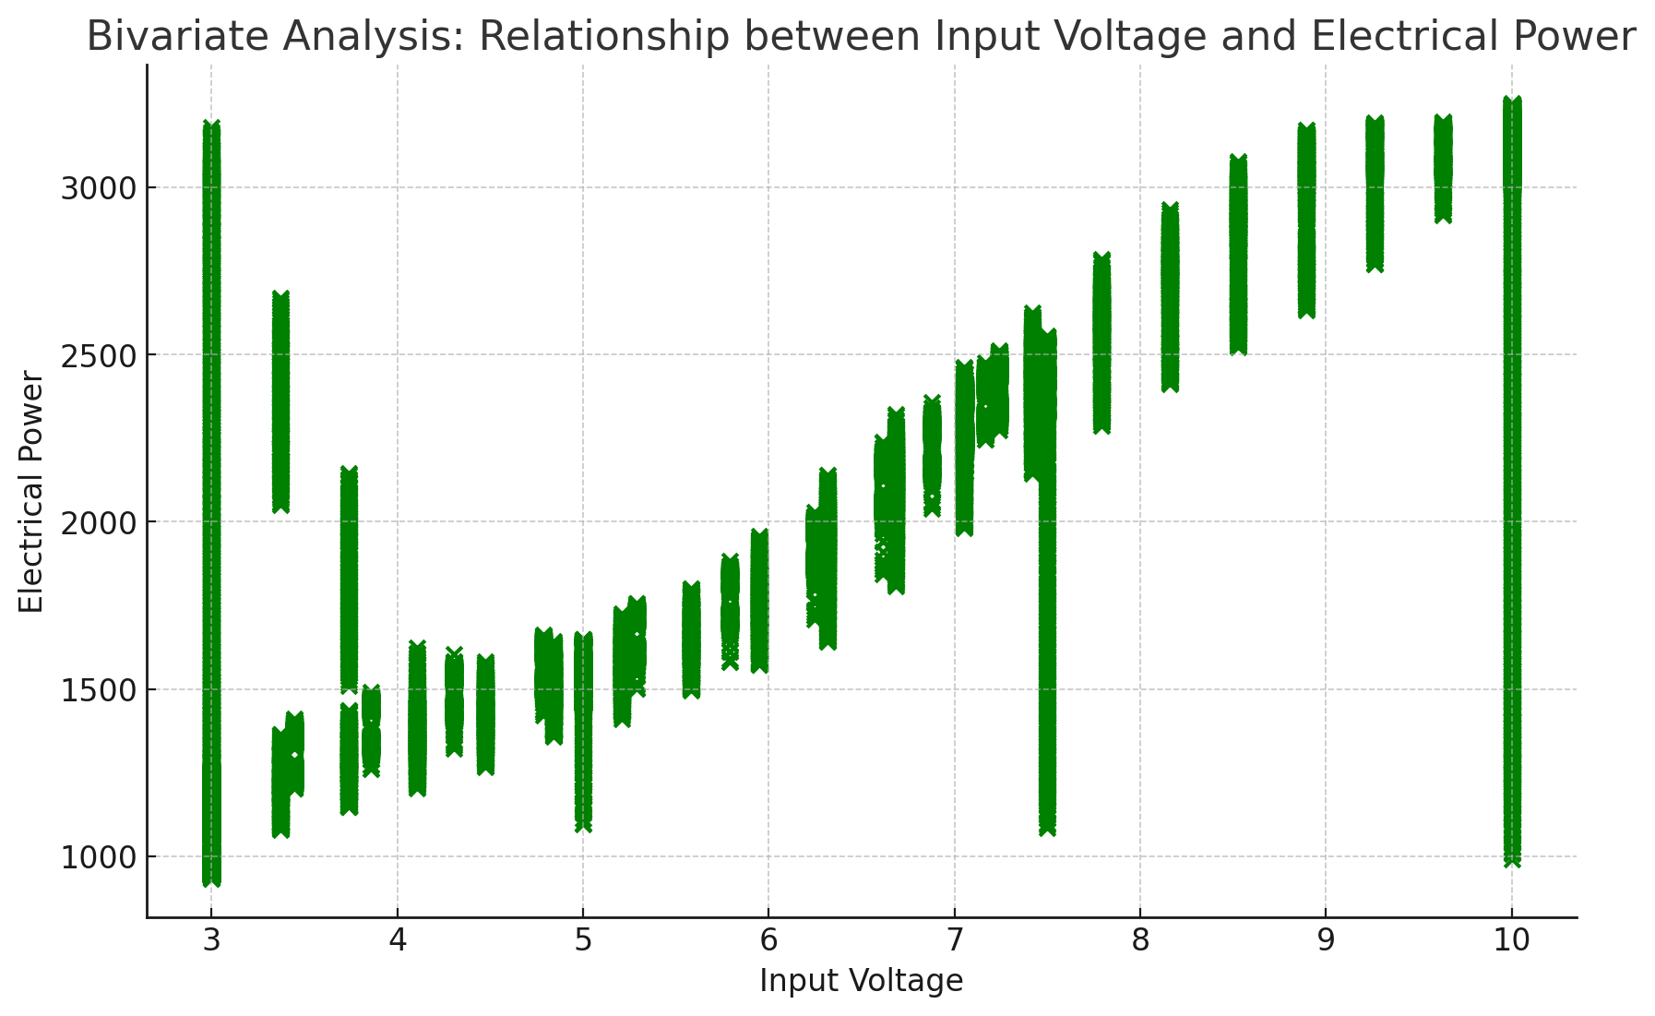
Relationship between Input Voltage and Electrical Power: The scatter plot reveals a strong positive relationship between input_voltage and el_power.
Correlation Coefficient: The correlation coefficient between input_voltage and el_power is approximately 0.88, indicating a strong positive linear relationship.
These analyses suggest that as input voltage increases, electrical power also tends to increase.

Slide 8
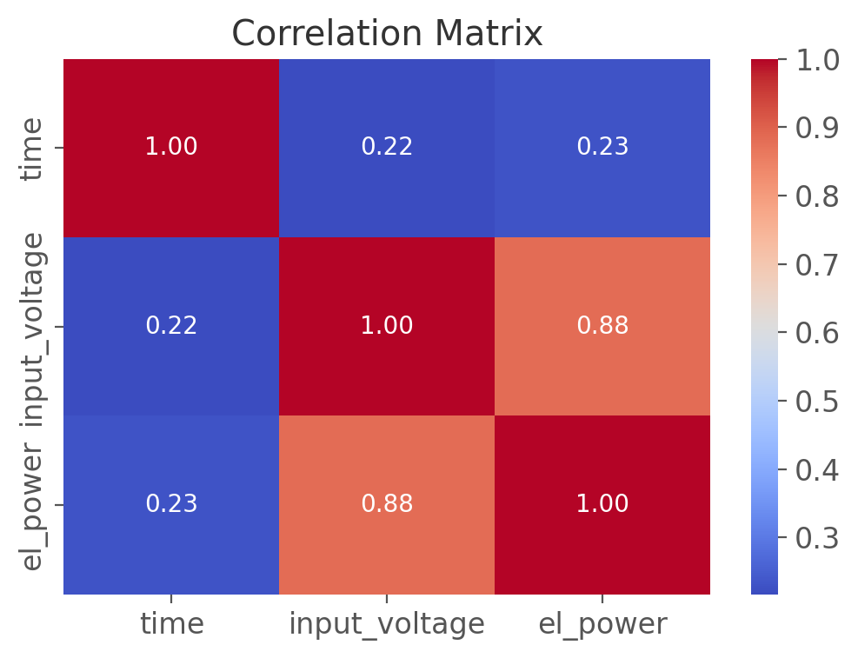
Correlation Analysis
The correlation matrix provides the correlation coefficients between variables. There is a strong positive correlation between input_voltage and el_power. This suggests a close linear relationship between these two variables.

Slide 9
CONCLUSION ON EDA
The EDA process yielded several important findings:
There were no missing values
There were no outliers
The input voltage appears to be roughly bimodal, with peaks around 3 and 10. This suggests that the voltage may alternate between certain levels or there may be specific conditions leading to different operating ranges.
The electrical power (el_power) has a right-skewed distribution, indicating a concentration of values at the lower end, with fewer instances of high-power readings.
The correlation analysis shows a strong positive correlation between input_voltage and el_power.

Slide 10
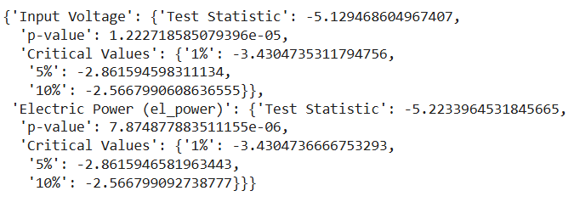
MACHINE LEARNING
Before training the models, we had to check for stationarity.
Input Voltage: If the p-value is below 0.05 and the test statistic is lower than the critical values, we conclude that input_voltage is stationary. This means it does not require further transformation for stationarity.
Electric Power (el_power): If the p-value is above 0.05 and the test statistic does not meet the critical thresholds, we conclude that el_power is non-stationary. In this case, transformations, such as differencing, may be needed to make the series stationary for time series modeling of which we deed

Slide 11
MACHINE LEARNING
Data Preparation
2.1 Feature Selection
The dataset, named combined_df, contains three columns: time, input voltage, and electric power (el_power). Time and input voltage are selected as the independent features to predict the target variable, electric power.
2.2 Scaling : We apply Min-Max scaling to the target variable, electric power, to normalize its values to a range between 0 and 1. This normalization step is performed to maintain consistency in model evaluation.
2.3 Train-Test Split:
To evaluate the model's generalization capabilities, the dataset is split into training and test sets in an 80-20 ratio. The first 80% of the data is used for training, while the remaining 20% is reserved for testing.

Slide 12
MODEL PERFORMANCE
model | Mean Squared Error | Root Mean Squared Error | R-squared
Linear Regression | 66237.73180877144 | 257.3669205798823 | 0.8664183919819917
Support Vector Regressor (SVR) | 487337.53334977466 | 698.0956477086609 | 0.017186585731307047
Gradient Boosting Regressor | 93297.36568580059 | 305.4461747768346 | 0.8118472388497001
Random Forest Regressor | 119160.98526304537 | 345.1970238328328 | 0.75968808729136
LSTM | 120338.74034796444 | 346.89874653559133 | 0.7573368272629472
ANN | 181905.6602606381 | 426.5039979421507 | 0.6331509255880685
MLP | 151084.731183031 | 388.6961939394712 | 0.695307481290819

Slide 13
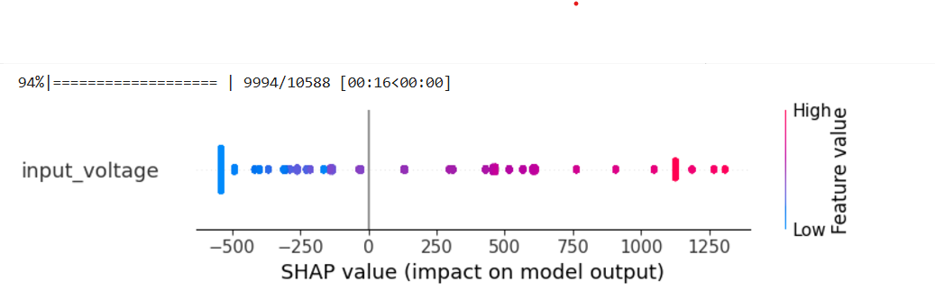
SHAP EXPLAINABILITY FOR FEATURE IMPORTANCE SVM
Feature input-voltage has a crucial influence on the model outcome. Magnitude of the SHAP values indicates the strength of contribution to the prediction.
As the input-voltage increases-which is moving from blue to red-the SHAP values shift positively, meaning higher input-voltage values lead to higher predicted el-power.

